Slide 1
Intro to Neural Nets
Week 6: RNNs for Forecasting

Slide 2

Today’s Agenda
Basic Setup for Forecasting
Train vs. validation / test, and setting up data.
Sequence Data
Temporal (1D) Convolution
Recurrent Neural Networks (RNNs):
SimpleRNN
LSTM (Long Short-Term Memory)
GRU (Gated Recurrent Unit)
Other Stuff
Bidirectional RNN
Advanced Forecasting

Slide 3
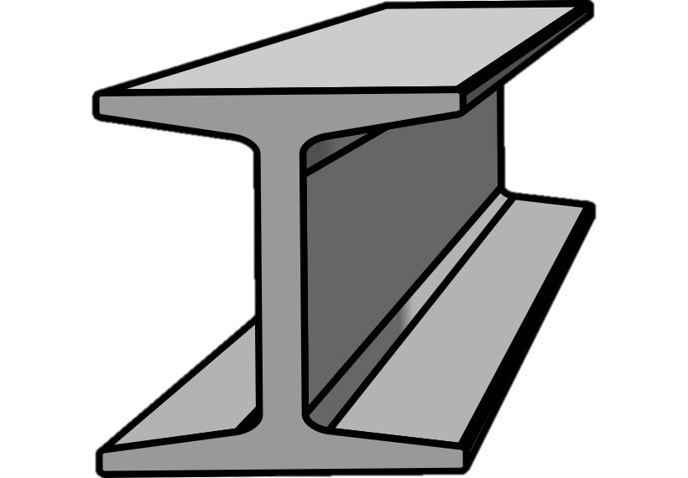
Basic Structure for Forecasting Problems
Earlier Data Serves as Training, Later Data Serves as Validation / Holdout
Never train on future data and test on historical data.
Temporal precedence often has a big effect on predictive performance.
Structuring Time Series Data for Prediction
We need to construct sequences of fixed length followed by a prediction at some point in the future.
Handling Data
TensorFlow dataset generator / iterator so we do not have to store many overlapping sequences of values in memory.
Or we can make the sequences / labels from scratch.

Slide 4
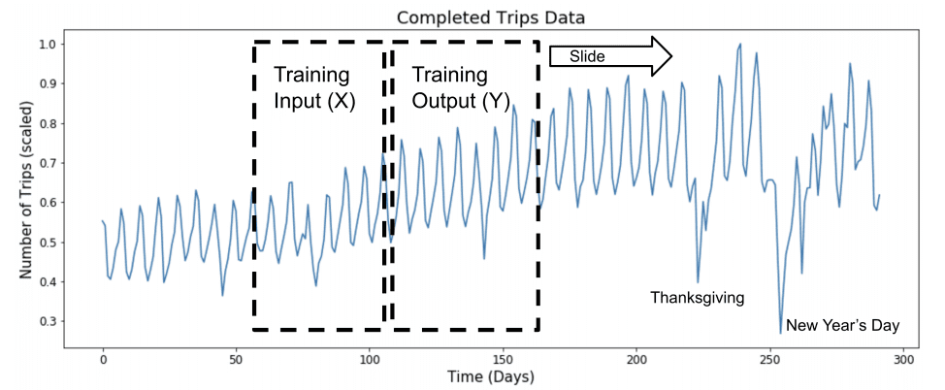
Preparing Data
Constructing our Observations / Labels
This might be one observation (a sequence of prior values, i.e., x’s, to one or more outcomes, i.e., y’s)

Slide 5
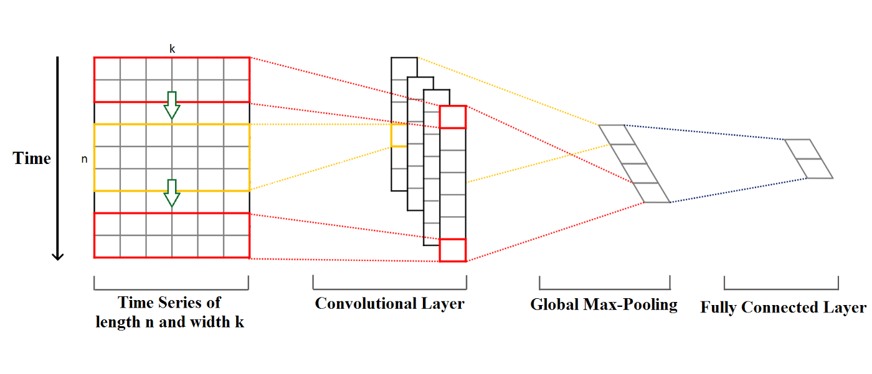
Temporal 1D Convolution
1D Convolution Accomplishes Same Goal as 2D
It only considers arrangement of features in one dimension (temporal ordering).
Compresses into shorter sequences, across the entire set of features (just as 2D Conv compresses matrices into smaller matrices, across the entire set of input channels (e.g., RGB).

Slide 6
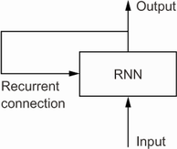
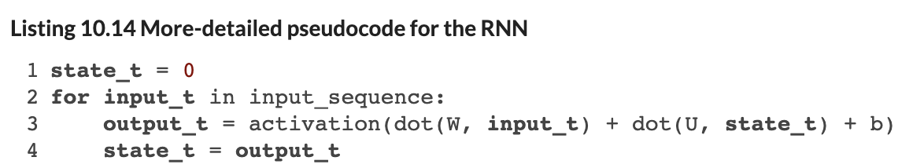
RNN: Processing /w Memory
Incorporating Memory into a NN
We include a feedback loop, where output feeds back into the same layer alongside the next input in the sequence (each gets its own separate set of weights, and they are able to interact with one another.

Slide 7
Keras RNN Layers
SimpleRNN
We can, in practice, unroll a one-lag RNN into a Dense Network, as follows.
It’s just a large Dense network with many inputs and many outputs. The inputs are arranged to interact with each other on the basis of their temporal sequencing in the data.
In practice we cannot use SimpleRNNs to achieve meaningful memory (vanishing gradients arise quickly).

Slide 8
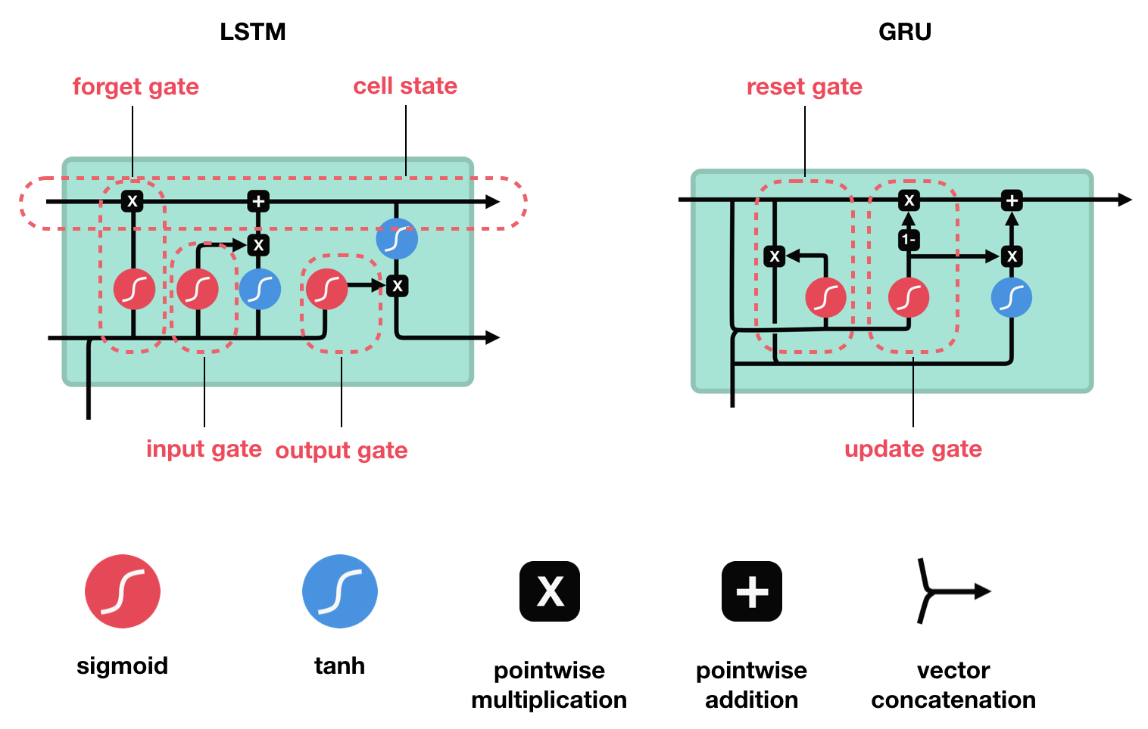
Keras RNN Layers
Long Short-Term Memory (LSTM)
We add what’s called a “carry track” – this is an additional connection that combines output at step t, inputs at step t, and the last carry track’s output. The topology means your network can ‘learn’ to use these connections as passthroughs for old info, or it can learn to ‘block’ that information in favor of more recent information (whatever is useful for accurate prediction).
Carry tracks are basically just another degree of freedom for learning how to use lagged information.
These ideas inspired the design of LSTM units, but nothing guarantees that these gates serve these functions…

Slide 9
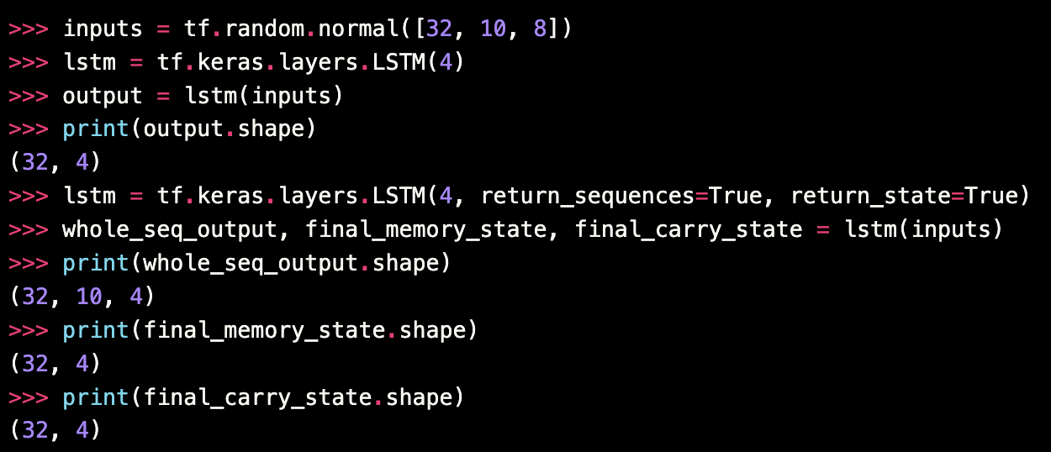
Keras RNN Layers
Long Short-Term Memory (LSTM)
Notes:
We have here a batch of 32 sequences (random values in this case), each is 10 values in length, and each value is an 8-element vector, maybe these are vector embeddings of words, I dunno. We then have 4 LSTM units, each of which will accept the input in parallel. So, each of those 4 LSTM units could be unrolled, and be seen to be taking the 10-vector sequence, separately, and learning something different about the sequence. All 4 produce a single output at the end of processing the sequence, hence why we end up with 4 outputs for the 32 observations (sequences). If we return_sequences=True, it means that every time step spits out an output, in addition to passing that output onward to the next temporal step in the LSTM. So, we end up with 10 outputs from each of the 4 LSTM units, a sequence-to-sequence mapping.

Slide 10
Keras RNN Layers
Gated Recurrent Unit (GRU)
Less complex than an LSTM. Combines elements of the LSTM into simpler gated structure.
Fits more quickly, with less data, but memory tends to be shorter.
More common in NLP tasks, e.g., because “within sentence” or “within paragraph” memory is often sufficient.

Slide 11
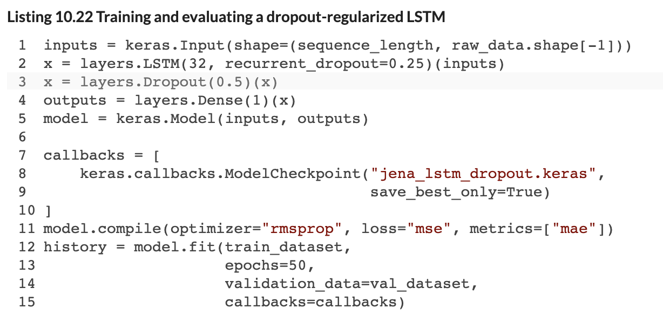
Fighting Overfitting in RNNs
Recurrent Dropout
We apply dropout in a fixed fashion to all the recurrent steps within an RNN layer.
The recurrent_dropout argument achieves this (ensures we are applying it homogenously at each time step).
The dropout argument applies dropout to the inputs entering the RNN layer (like the Dropout you’ve seen previously).

Slide 12
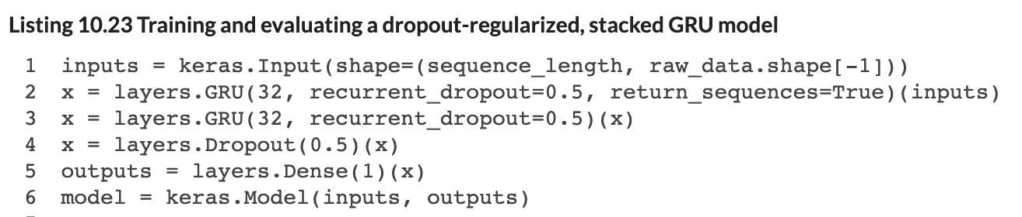
Stacking RNN Layers
Stacked Layers (LSTM or GRUs)
Same as other ‘layer’ types, but we need to pass the entire sequence of outputs (not just the last output). We do this with the ‘return_sequences=True’ argument to the layer.

Slide 13
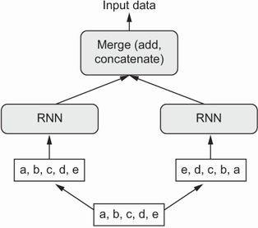
Bidirectional RNNs
Some Sequences Yield Information in Both Directions
Consider that, in language, words that come later in a sentence can be predictive of what came before.
Bidirectional RNNs implement a standard RNN, but they also incorporate a parallel layer implementation that takes the sequence ordered in reverse.

Slide 14
Advanced Scenarios
Forecasting Multiple Series in Parallel
Sometimes we need to implement forecasts for a panel of units (e.g., revenue of different stores in a chain, or demand for transit at different transit stops).
We can implement such multivariate timeseries forecasting in Keras a well. Choices need to be made about topology and how to handle the different series’.
Sometimes (often) it can be better to train separate forecasting models for each series.
Multi-Step Forecasting
We may want to forecast over a range of future values. These different horizons can be setup as different labels. The model will optimize jointly over the different labels.
You can also train different models for different horizons.

Slide 15
Questions?
Notes:
Weights are not initialized until you “build” the model (or compile it, which will first build).

